Slide 1
Project Procurement Management
School of Computer and Security Science
CSG 2344
Project Methods and Professionalism
ECU Copyright 2014 – CSG 2344 School of Computer and Security Science

Slide 2
Project Management –
Knowledge Areas
There are Ten Knowledge Management Areas.
(there used to only be 9)
Scope
Time
Cost
Quality
Communications
Risk
Human Resources
Procurement
Stakeholders
Integration
ECU Copyright 2014 – CSG 2344 School of Computer and Security Science

Slide 3
Learning Objectives
Understand the importance of project procurement management and the increasing use of outsourcing for information technology projects
Describe the work involved in planning purchases and acquisitions for projects, the contents of a procurement management plan and contract statement of work, and calculations involved in a make-or-buy analysis
Discuss what is involved in planning contracting, including the creation of various procurement documents and evaluation criteria for sellers

Slide 4
Learning Objectives (continued)
Understand the process of requesting seller responses: the difference between proposals and bids
Describe the seller selection process and recognize different approaches for evaluating proposals or selecting suppliers
Discuss the importance of good contract administration
Describe the contract closure process
Discuss types of software available to assist in project procurement management

Slide 5
Importance of Project Procurement Management
Procurement means acquiring goods and/or services from an outside source
Other terms include purchasing and outsourcing
Experts predict that global spending on computer software and services will continue to grow
People continue to debate whether offshore outsourcing helps their own country or not
ECU Copyright 2014 – CSG 2344 School of Computer and Security Science

Slide 6
Debates on Outsourcing
Some companies, such as Wal-Mart, prefer to do no outsourcing at all, while others do a lot of outsourcing
Most organizations do some form of outsourcing to meet their IT needs and spend most money within their own country
The U.S. temporary workforce continues to grow as people work for temporary job agencies so they can more easily move from company to company
ECU Copyright 2014 – CSG 2344 School of Computer and Security Science

Slide 7
Why Outsource?
To reduce both fixed and recurrent costs
To allow the client organization to focus on its core business
To access skills and technologies
To provide flexibility
To increase accountability
ECU Copyright 2014 – CSG 2344 School of Computer and Security Science

Slide 8
More on Outsourcing
Seven Tips for Outsourcing
  Know what you are outsourcing
  Understand Risks & dependencies
  Assess Outsourcer’s Risk management Level
  Assess experience level of Outsourcer’s staff
  Protect your Data
  Transparency in monitoring & controlling data & services
  Clear & Explicit Service Level Agreements
ECU Copyright 2014 – CSG 2344 School of Computer and Security Science

Slide 9
Avoid Outsourcing Failure
Create winners on both sides
Establish & maintain good governance
Be aware of cultural differences
Refocus & retrain existing organisation
Use acceptance criteria
Adopt an achievement based model
Be consistent and persevere
Use 3rd party advisors to assist

Slide 10
Contracts
A contract is a mutually binding agreement that obligates the seller to provide the specified products or services and obligates the buyer to pay for them
Contracts can clarify responsibilities and sharpen focus on key deliverables of a project
Because contracts are legally binding, there is more accountability for delivering the work as stated in the contract
A recent trend in outsourcing is the increasing size of contracts
ECU Copyright 2014 – CSG 2344 School of Computer and Security Science

Slide 11
What Went Wrong?
Companies often change their minds about procurement; for example, JPMorgan Chase announced a seven-year, $5 billion deal to outsource much of its data processing to IBM, but they revoked the contract less than two years into its existence because the procurement plan no longer fit their business strategy
The Australian Computer Society says sending work offshore may lower the number of students entering IT courses, deplete the number of skilled IT professionals, and diminish the nation’s strategic technology capability
Procurement can also cause security problems, including the protection of intellectual property, integrity of data, and the reliability of infrastructure in offshore locations

Slide 12
Project Procurement Management Processes
Project procurement management: acquiring goods and services for a project from outside the performing organization
Processes include:
  Planning purchases and acquisitions: determining what to procure, when, and how
  Planning contracting: describing requirements for the products or services desired from the procurement and identifying potential sources or sellers (contractors, suppliers, or providers who provide goods and services to other organizations)

Slide 13
Project Procurement Management Processes (continued)
Requesting seller responses: obtaining information, quotes, bids, offers, or proposals from sellers, as appropriate
Selecting sellers: choosing from among potential suppliers through a process of evaluating potential sellers and negotiating the contract
Administering the contract: managing the relationship with the selected seller
Closing the contract: completing and settling each contract, including resolving any open items

Slide 14
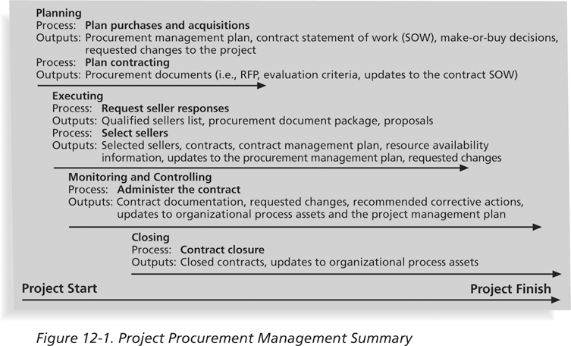
Project Procurement Management Summary

Slide 15
Planning Purchases and Acquisitions
Identifying which project needs can best be met by using products or services outside the organization
Sometimes there is no need to buy any products or services from outside the organization.
ECU Copyright 2014 – CSG 2344 School of Computer and Security Science

Slide 16
What Went Right?
Several organizations, such as The Boots Company PLC in England, outsource their IT services to save money compared with the cost of running the systems themselves
Carefully planning procurement can also save millions of dollars, as the U.S. Air Force did by using a unit pricing strategy for a large office automation project

Slide 17
Tools and Techniques for Planning Purchases and Acquisitions
Make-or-buy analysis: general management technique used to determine whether an organization should make or perform a particular product or service inside the organization or buy from someone else
Often involves financial analysis
Experts, both internal and external, can provide valuable inputs in procurement decisions
ECU Copyright 2014 – CSG 2344 School of Computer and Security Science

Slide 18
Make-or-Buy Example
Assume you can lease an item you need for a project for $800/day; to purchase the item, the cost is $12,000 plus a daily operational cost of $400/day
How long will it take for the purchase cost to be the same as the lease cost?
ECU Copyright 2014 – CSG 2344 School of Computer and Security Science

Slide 19
Make-or Buy Solution
Set up an equation so both options, purchase and lease, are equal
In this example, use the following equation; let d be the number of days to use the item:
  $12,000 + $400d = $800d
  Subtracting $400d from both sides, you get:
  $12,000 = $400d
  Dividing both sides by $400, you get:
  d = 30
If you need the item for more than 30 days, it is more economical to purchase it

Slide 20
Types of Contracts
Different types of contracts can be used in different situations
  Fixed price or lump sum contracts: involve a fixed total price for a well-defined product or service
  Cost reimbursable contracts: involve payment to the seller for direct and indirect costs
  Time and material contracts: hybrid of both fixed price and cost reimbursable contracts, often used by consultants
  Unit price contracts: require the buyer to pay the seller a predetermined amount per unit of service
A single contract can actually include all four of these categories, if it makes sense for that particular procurement

Slide 21
Cost Reimbursable Contracts
Cost plus incentive fee (CPIF): the buyer pays the supplier for allowable performance costs plus a predetermined fee and an incentive bonus
Cost plus fixed fee (CPFF): the buyer pays the supplier for allowable performance costs plus a fixed fee payment usually based on a percentage of estimated costs
Cost plus percentage of costs (CPPC): the buyer pays the supplier for allowable performance costs plus a predetermined percentage based on total costs
ECU Copyright 2014 – CSG 2344 School of Computer and Security Science

Slide 22
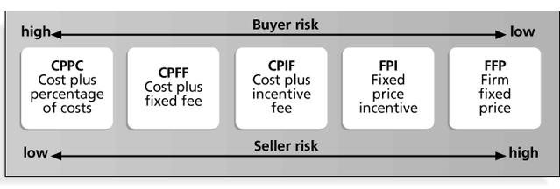
Contract Types Versus Risk

Slide 23
Contract Clauses
Contracts should include specific clauses to take into account issues unique to the project
Can require various educational or work experience for different pay rights
A termination clause is a contract clause that allows the buyer or supplier to end the contract
ECU Copyright 2014 – CSG 2344 School of Computer and Security Science

Slide 24
Procurement Management Plan
Describes how the procurement processes will be managed, from developing documentation for making outside purchases or acquisitions to contract closure
Content varies based on project needs
ECU Copyright 2014 – CSG 2344 School of Computer and Security Science

Slide 25
Contract Statement of Work (SOW)
A statement of work is a description of the work required for the procurement
If a SOW is used as part of a contract to describe only the work required for that particular contract, it is called a contract statement of work
A SOW is a type of scope statement
A good SOW gives bidders a better understanding of the buyer’s expectations
ECU Copyright 2014 – CSG 2344 School of Computer and Security Science

Slide 26
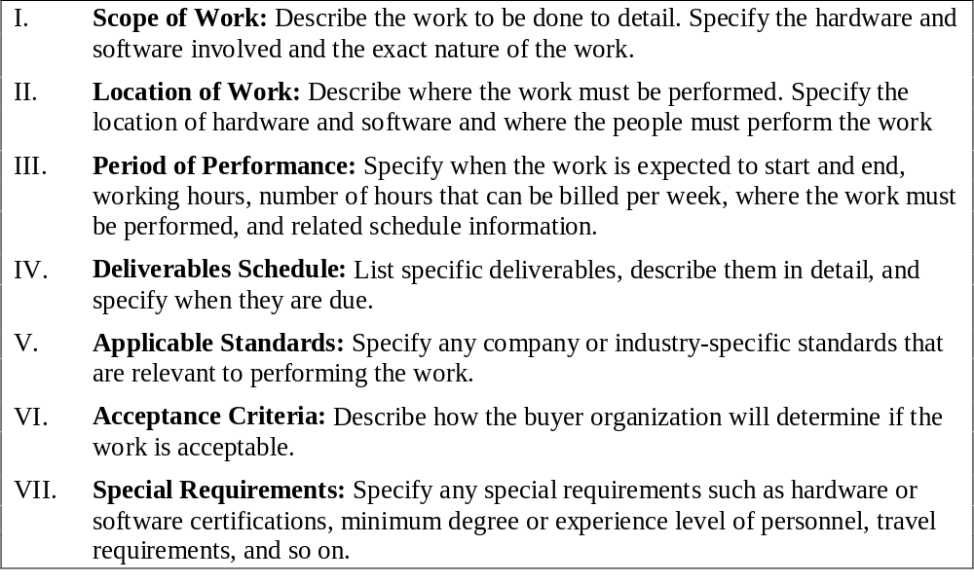
Statement of Work (SOW) Template

Slide 27
Planning Contracting
Involves preparing several documents needed for potential sellers to prepare their responses and determining the evaluation criteria for the contract award
  Request for Proposals: used to solicit proposals from prospective sellers
    A proposal is a document prepared by a seller when there are different approaches for meeting buyer needs
  Requests for Quotes: used to solicit quotes or bids from prospective suppliers
    A bid, also called a tender or quote (short for quotation), is a document prepared by sellers providing pricing for standard items that have been clearly defined by the buyer
ECU Copyright 2014 – CSG 2344 School of Computer and Security Science

Slide 28
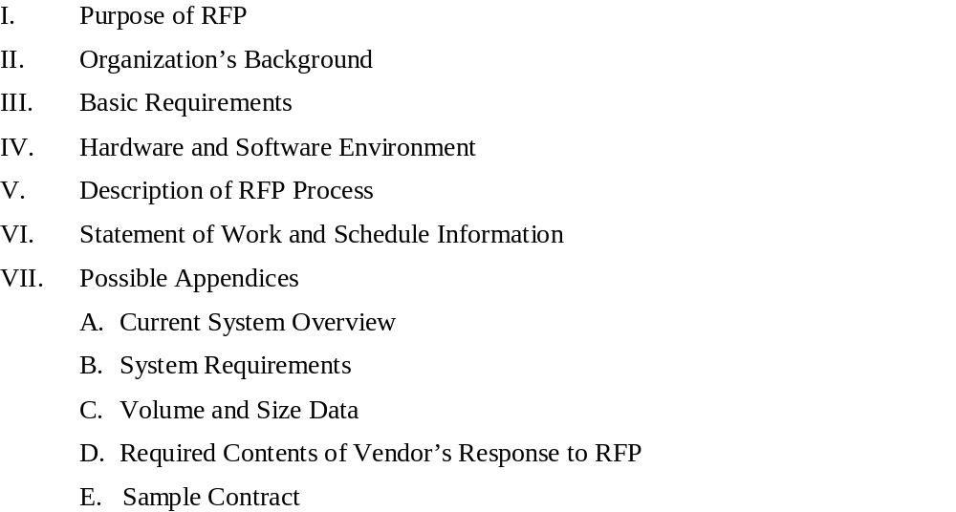
Request for Proposal (RFP) Template

Slide 29
Evaluation Criteria
It’s important to prepare some form of evaluation criteria, preferably before issuing a formal RFP or RFQ
Beware of proposals that look good on paper; be sure to evaluate factors, such as past performance and management approach
Can require a technical presentation as part of a proposal

Slide 30
Requesting Seller Responses
Deciding whom to ask to do the work, sending appropriate documentation to potential sellers, and obtaining proposals or bids
Organizations can advertise to procure goods and services in several ways
  Approaching the preferred vendor
  Approaching several potential vendors
  Advertising to anyone interested
A bidders’ conference can help clarify the buyer’s expectations
ECU Copyright 2014 – CSG 2344 School of Computer and Security Science

Slide 31
Selecting Sellers
Also called source selection
Involves:
  Evaluating proposals or bids from sellers
  Choosing the best one
  Negotiating the contract
  Awarding the contract
ECU Copyright 2014 – CSG 2344 School of Computer and Security Science

Slide 32
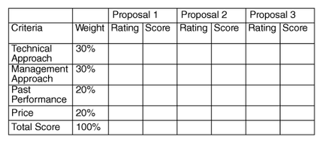
Sample Proposal Evaluation Sheet

Slide 33
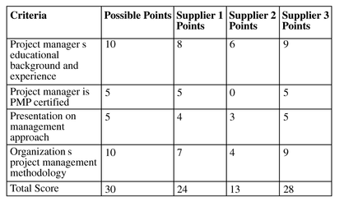
Detailed Criteria for Selecting Suppliers

Slide 34
Seller Selection Process
Organizations often do an initial evaluation of all proposals and bids and then develop a short list of potential sellers for further evaluation
Sellers on the short list often prepare a best and final offer (BAFO)
Final output is a contract signed by the buyer and the selected seller

Slide 35
Media Snapshot
Information technology has made a tremendous impact on how organizations select sellers
The Interactive Advertising Bureau and PricewaterhouseCoopers reported that U.S. Internet advertising revenues for the first half of 2006 were almost $8 billion, a new record and a 37 percent increase over the first half of 2005
Google and Yahoo! charge advertisers each time a user clicks on that advertiser’s site
Other companies, like DoubleClick, Inc., provide digital marketing technology services

Slide 36
Administering the Contract
Ensures that the seller’s performance meets contractual requirements
Contracts are legal relationships, so it is important that legal and contracting professionals be involved in writing and administering contracts
It is critical that project managers and team members watch for constructive change orders, which are oral or written acts or omissions by someone with actual or apparent authority that can be construed to have the same effect as a written change order

Slide 37
Suggestions for Change Control in Contracts
Changes to any part of the project need to be reviewed, approved, and documented by the same people in the same way that the original part of the plan was approved
Evaluation of any change should include an impact analysis; how will the change affect the scope, time, cost, and quality of the goods or services being provided?
Changes must be documented in writing; project team members should also document all important meetings and telephone phone calls

Slide 38
Suggestions for Change Control in Contracts (continued)
Project managers and teams should stay closely involved to make sure the new system will meet business needs and work in an operational environment
Have backup plans
Use tools and techniques, such as a contract change control system, buyer-conducted performance reviews, inspections and audits, and so on

Slide 39
Closing the Contract
Involves completing and settling contracts and resolving any open items
The project team should:
  Determine if all work was completed correctly and satisfactorily
  Update records to reflect final results
  Archive information for future use
The contract itself should include requirements for formal acceptance and closure
ECU Copyright 2014 – CSG 2344 School of Computer and Security Science

Slide 40
Tools to Assist in Contract Closure
Procurement audits identify lessons learned in the procurement process
A records management system provides the ability to easily organize, find, and archive procurement-related documents
ECU Copyright 2014 – CSG 2344 School of Computer and Security Science

Slide 41
Chapter Summary
Project procurement management involves acquiring goods and services for a project from outside the performing organization
Processes include:
  Planning purchases and acquisitions
  Planning contracting
  Requesting seller responses
  Selecting sellers
  Administering contracts
  Closing contracts
ECU Copyright 2014 – CSG 2344 School of Computer and Security Science

